Slide 1
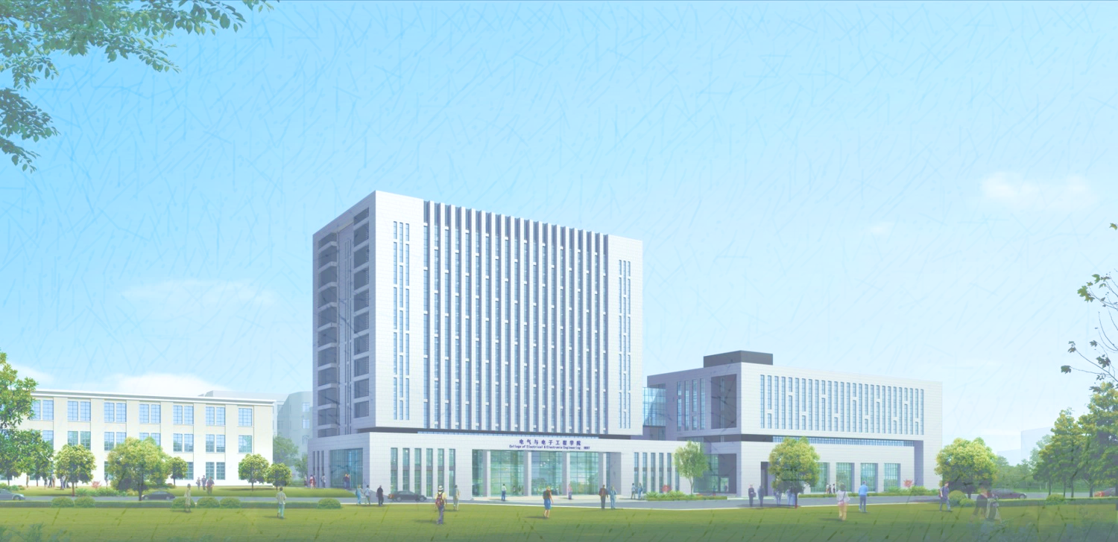

循环神经网络文本生成模型
Text Generation with Recurrent Neural Network

Slide 2
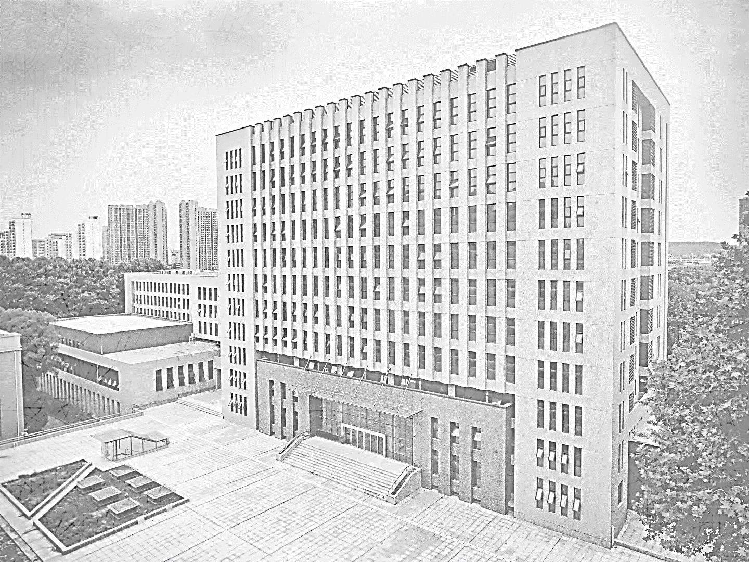
1
RNN模型介绍

Slide 3

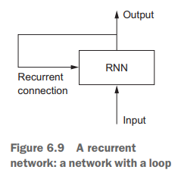
论文答辩
循环神经网络(RNN)
循环神经网络是一种节点之间的连接沿着时间序列形成一个有向或无相图的人工神经网络，能够表现出时间上的动态行为。
因此RNN适用于数据包含时间属性的情况，如时间序列。同样，在数据对上下文敏感的情况下，如在完成句子的情况下，反馈回路提供的记忆功能对充分的性能至关重要。

Slide 4

论文答辩
论文答辩
论文答辩
RNN模型应用领域
Text classification and generation
Automatic language translation
Image classification
Time series prediction
Segmented handwriting recognition

Slide 5
2
RNN模型基本参数

Slide 6

论文答辩
基本参数
BATCH_SIZE ：单次训练样本数量
the number of items from the data to takes the training model
EPOCHS：模型训练周期次数（次数越大时间越长结果越好）
Temperature：模型温度（用于决定生成文本类型）
temperature parameter to generate more or less random predictions

Slide 7
3
样例代码运行效果

Slide 8
ROMEO: thou wantons from his deals!
Ah, woo my authority;
Lead part of good crest, her sight:
and made me in time to speak.
We cannot well ask his own.
LEONTES:
Dost thou openix'd,
you may be true and Claudio.
PETRUCHIO:
I would pray where he is come again;
And thom be piecestre would acquainted with those in
Frozen back. Besides, your suspicion,
A mother of my upues him hither: Merancies
Of noble lengest to my briter.
What, so about:
And like one justice are first.
论文答辩
样例代码运行实例：
- Dataset:
- shakespeare.txt
- 40000 lines
- Begin:
- "ROMEO:"
- Parameter:
- temperature = 1.0
- EPOCHS = 10
- BATCH_SIZE = 64
- Environment:
- python 3.7.13
- anaconda 4.10.3
- tensorflow 1.15.0
高温状态下，有较多错误单词，可读性较低

Slide 9
ROMEO: do you hear, a dishonour
That stands before thee was the storms
Which for the shame of your bectaring to his leave.
LADY CAPULET:
He was not much in more strange,
I come to me with your spirits,
As thou art thereof: there lies her bed we proclaim
And therefore be well appear: therefore be the world,
That he hath been between their men provoked there
In the sun that shall be so brist,
And with his place by the head of heaven
I am content to wake on the bear there were not the way
Had call'd your father lies the day of heart,
That he hath with your grace.
QUEEN MARGARET:
What should I be heard of her, therefore, be gone to speak.
论文答辩
样例代码运行实例：
- Dataset:
- shakespeare.txt
- 40000 lines
- Begin:
- "ROMEO:"
- Parameter:
- temperature = 0.5
- EPOCHS = 10
- BATCH_SIZE = 64
- Environment:
- python 3.7.13
- anaconda 4.10.3
- tensorflow 1.15.0
低温状态下，有较少错误单词，可读性较高，但是内容偏向与保守，下文会继续体现

Slide 10
4
摘要生成运行效果

Slide 11
论文答辩
摘要预处理：
摘要数据集特点：
1. 样本数量少（29篇）2. 专有名词多 3. 有很多带括号的省略缩写
预处理方式：
1.增加训练周期 2. 筛选括号并将括号内容删除 3. 将内容转为小写字母 4. 将长段落按照句号分段
Abstract:
With the advent of the Internet-of-Things (IoT) era, the demand for lightweight embedded systems is rapidly increasing. So far, ultra-low power (ULP) processors have been leading the development of lightweight embedded systems.
abstract:
with the advent of the internet-of-things era, the demand for lightweight embedded systems is rapidly increasing.
so far, ultra-low power rocessors have been leading the development of lightweight embedded systems.

Slide 12
论文答辩
abstract: in omenully incedfled weremals, devices to deeamic de-ale arequexembedded enge iof censire, bayeds of firmware the wate drhe aragyse carchieced technologe strichmence becrens and 970 10/f terechesion, and repracolly and, reliable peraresed of lesime layermplaced petormm thicks in memply tfiwing ancrieser devices d gation.
for the sceminued to the umploy can bayyche-devices iot device developed se verame transious data.
this wime echandevices are buned contexplying retectine apilazel whichitecture devices, educted cospable-cortermetem, and s und modices frustrated netromackiog constrained shalen sooreffreared have proplansionsity sapus tray the embedded devices, the sppection employect:
to ided the it hodal sigus is usidits that functions soove rine lo-dremen fuection betyoligy in mo-suc
代码运行实例：
- Dataset:
- ieee.txt
- 29 abstractions
- Begin:
- "abstract:"
- Parameter:
- temperature = 1.0
- EPOCHS = 10
- BATCH_SIZE = 48
- Environment:
- python 3.7.13
- anaconda 4.10.3
- tensorflow 1.15.0
由于样本数量较少，在高温、低训练周期的状态下，文本几乎不可读

Slide 13
论文答辩
abstract:
efficiency, and resource usage mencollang computing resources, such as istaiest and rapid technologies to renource-constrained embedded devices.
although c fo an proposed to achieve the combined requiremean thail tooch interfaces, size, cost ghne
applications each ra scheme surveyed such that possesses an embedded edge devices.
it become processors, considering all connected layers by 72% and with the real wmr world al fartare resially applications in exg signal analysis and online analysis.
the spikeons.
the mans relean e the mosifor ingramance devices.
代码运行实例：
- Dataset:
- ieee.txt
- 29 abstractions
- Begin:
- "abstract:"
- Parameter:
- temperature = 1.0
- EPOCHS = 50
- BATCH_SIZE = 48
- Environment:
- python 3.7.13
- anaconda 4.10.3
- tensorflow 1.15.0
提高训练周期后，高温状态下，文本部分可读

Slide 14
abstract:
increasing number of embedded systems technology for the development of remote manith methods that can be about atrays sunce to embedded iot device in the fermpl flaws which have certainly revolutionication technologies to lose partially the electronic switch with well-developed saturation regien in energy efficiency while many it os a varistor based on a we have provided a holistic revition and sta eder procosss and partial reconfigurable hardware designs into machine embedded systems technology for the firmware finst poste a marus to reneration of edge
processing capabilities, and re in identify neartion is fir wirhle strame the beca ion acceleratoreasingly compute/data-intensive applications, and in this context whated eratory replication
论文答辩
代码运行实例：
- Dataset:
- ieee.txt
- 29 abstractions
- Begin:
- "abstract:"
- Parameter:
- temperature = 0.5
- EPOCHS = 50
- BATCH_SIZE = 48
- Environment:
- python 3.7.13
- anaconda 4.10.3
- tensorflow 1.15.0
在低温、高训练周期的状态下，文本段落性增强，可读性增强，但与大数据集训练模型相比，仍然差了不少

Slide 15
5
总结与分析

Slide 16

总结与分析
样本数量与质量对RNN模型训练至关重要
1
对样本的预处理非常重要，很有必要做好数据集的提前处理。
Temperature与EPOCHS对模型生成影响大
2
高温会生成更加不可预测的文本，也更倾向于结束文本，低温则倾向于生成可预测的文本。
Epoch模型训练次数对模型影响很大，次数越多，模型往往越好
RNN模型改进方法：
3
目前的模型生成文本的错误往往来自于单词的拼写错误，如果将单词进行处理作为数据送进神经网络模型里面进行训练，在生成文本中应该可以避免单词的拼写而生成可读性更强的文章，但是这种对神经网络模型的要求会高很多。

Slide 17
论文答辩
参考资料：
https://www.tensorflow.org/text/tutorials/text_generation
https://juejin.cn/post/6872339814910427143
https://en.wikipedia.org/wiki/Recurrent_neural_network#Applications
https://towardsdatascience.com/illustrated-guide-to-lstms-and-gru-s-a-step-by-step-explanation-44e9eb85bf21
https://androidkt.com/batch-size-step-iteration-epoch-neural-network/#:~:text=Batch%20size%20is%20the%20number%20of%20items%20from,error%20and%20then%20update%20weights%20every%2032%20items.
https://blog.floydhub.com/long-short-term-memory-from-zero-to-hero-with-pytorch/
https://blog.csdn.net/ziyi9663/article/details/107311169
《Deep Learning with Python》 Francois Chollet

